Slide 1
Graduate Admission
Prediction System
PredictX — ML-Powered Admission Intelligence
UNIVERSITY
COLLEGE
PROGRAM
YEAR
Veer Narmad South Gujarat University
Dolat-Usha Institute, Valsad
Bachelor of Computer Applications
2025 – 2026
Guide: Dr. Darshna Rajput | Presented by: Shahil Pathan · Mubin Malek

Slide 2
⬡ OVERVIEW
Introduction
& Problem Statement
What is it?
500
7
A data analytics web project that predicts graduate admission chances using ML models trained on real academic data.
Records
Features
Problem
96%
Linear
Students applying for graduate programs often don't know their chances of admission based on their academic profile.
Accuracy
Regression
Solution
Analyze academic data (GRE, TOEFL, CGPA, Research etc.) and build a predictive model to estimate admission probability.

Slide 3
⬡ GOALS
Project Objectives
01
02
03
Dataset Analysis
Exploratory Analysis
Regression Model
Analyze the Graduate Admission dataset with 500 records and 9 columns.
Perform EDA to find patterns and correlations between features.
Build a Linear Regression model to predict admission probability.
04
05
06
Classification
Web Dashboard
Data Visualization
Classify results into High, Moderate, and Low chance categories.
Develop an interactive Flask web app with charts and prediction UI.
Create scatter plots, heatmaps, histograms, and distribution charts.

Slide 4
⬡ DATA
Dataset Overview
Admission Predict Ver1.1 — 500 records · 9 columns
500
9
7
0.34–0.97
Rows
Columns
Features
Chance Range
FEATURE
RANGE
DESCRIPTION
GRE Score
290–340
Graduate Record Exam Score
TOEFL Score
92–120
English Proficiency Score
Univ. Rating
1–5
University Rating
SOP
1–5
Statement of Purpose Strength
LOR
1–5
Letter of Recommendation
CGPA
6.8–9.92
Undergraduate GPA (Most Important)
Research
0 or 1
Research Experience
Chance
0.34–0.97
Target: Probability of Admission

Slide 5
⬡ STACK
Tools & Technologies
🐍
Python
🐼
Pandas
🔢
NumPy
Core programming language
Data manipulation & analysis
Numerical computations
📊
Matplotlib
🎨
Seaborn
🤖
Scikit-Learn
Static data visualization
Statistical visualizations
ML model training & evaluation
🌐
Flask
💻
HTML / CSS
📈
Chart.js
Web framework & routing
Frontend UI & styling
Interactive charts

Slide 6
⬡ ANALYSIS
Exploratory Data Analysis
01
Data Cleaning
KEY FINDINGS
Removed unnecessary columns (Serial No) and formatted dataset for ML pipeline using Pandas.
CGPA
Strongest predictor (0.88 corr.)
02
Missing Values
GRE Score
High impact (0.81 corr.)
Checked for null values — dataset was clean with no missing entries across all 500 records.
TOEFL
Strong influence (0.79 corr.)
03
Visualization
Created scatter plots, bar charts, heatmaps, histograms to identify patterns and distributions.
Research
Boosts chance by ~15%
Avg Chance
72% across all 500 students
04
Correlation
CGPA (0.88), GRE (0.81), TOEFL (0.79) showed strongest correlation with admission chance.
High Chance
Students with CGPA > 9.0

Slide 7
⬡ ML MODEL
Machine Learning Model
81.88%
0.0427
0.0609
400/100
R² Score
MAE
RMSE
Train/Test
FEATURE IMPORTANCE
TRAINING PIPELINE
CGPA
68.8%
1
Load CSV Dataset
Research
14.7%
2
Clean & Format Data
LOR
10.5%
3
Select 7 Features
TOEFL Score
1.8%
4
80/20 Train-Test Split
Univ. Rating
1.6%
5
Fit Linear Regression
GRE Score
1.5%
6
Evaluate R², MAE, RMSE
SOP
1.1%
7
Save as .pkl File

Slide 8
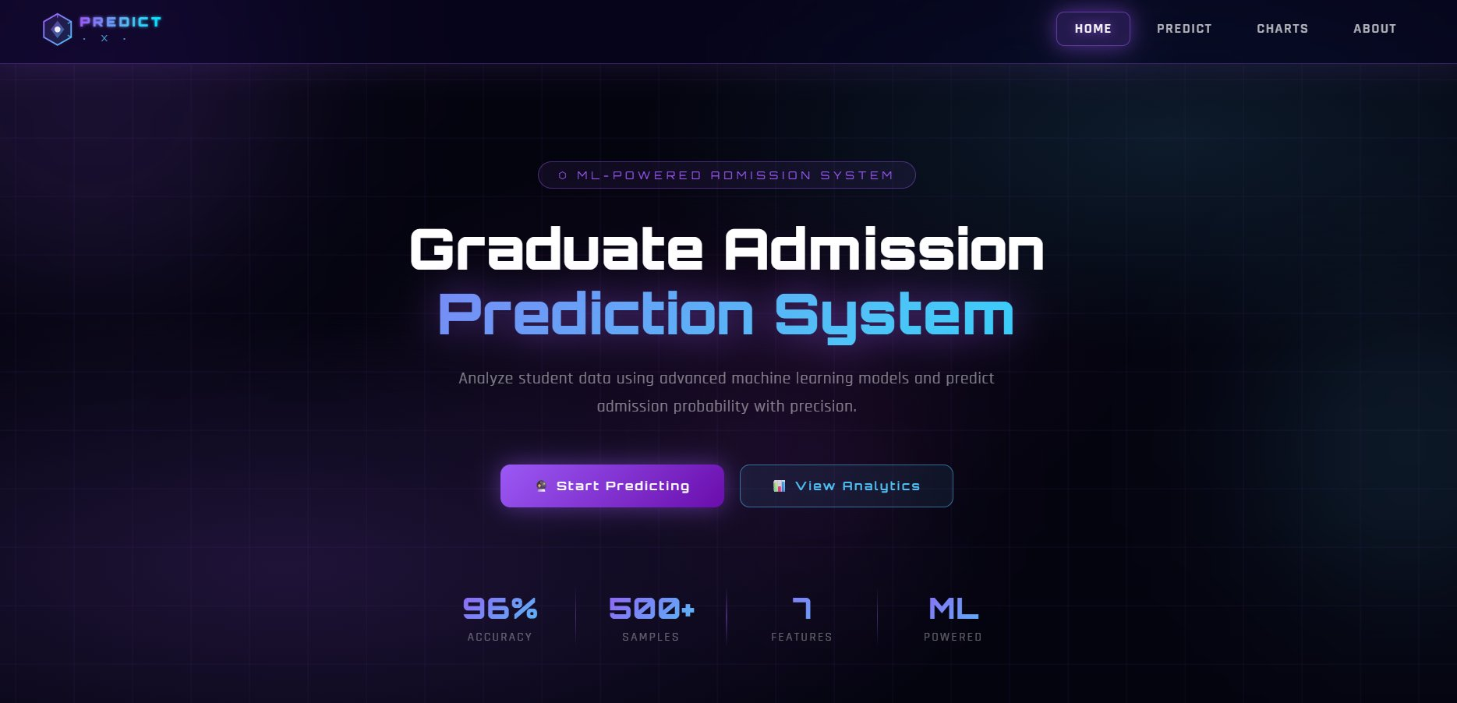
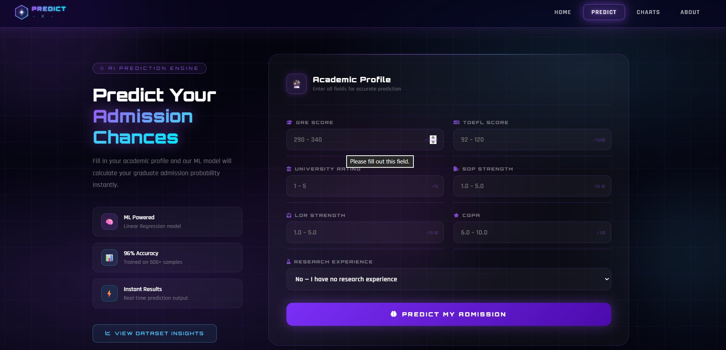
⬡ DASHBOARD
Web Dashboard
Home Page
Prediction Page
Graduate Admission Prediction System — Home
AI Prediction Engine — Academic Profile Form

Slide 9
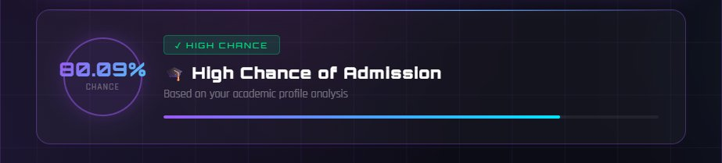
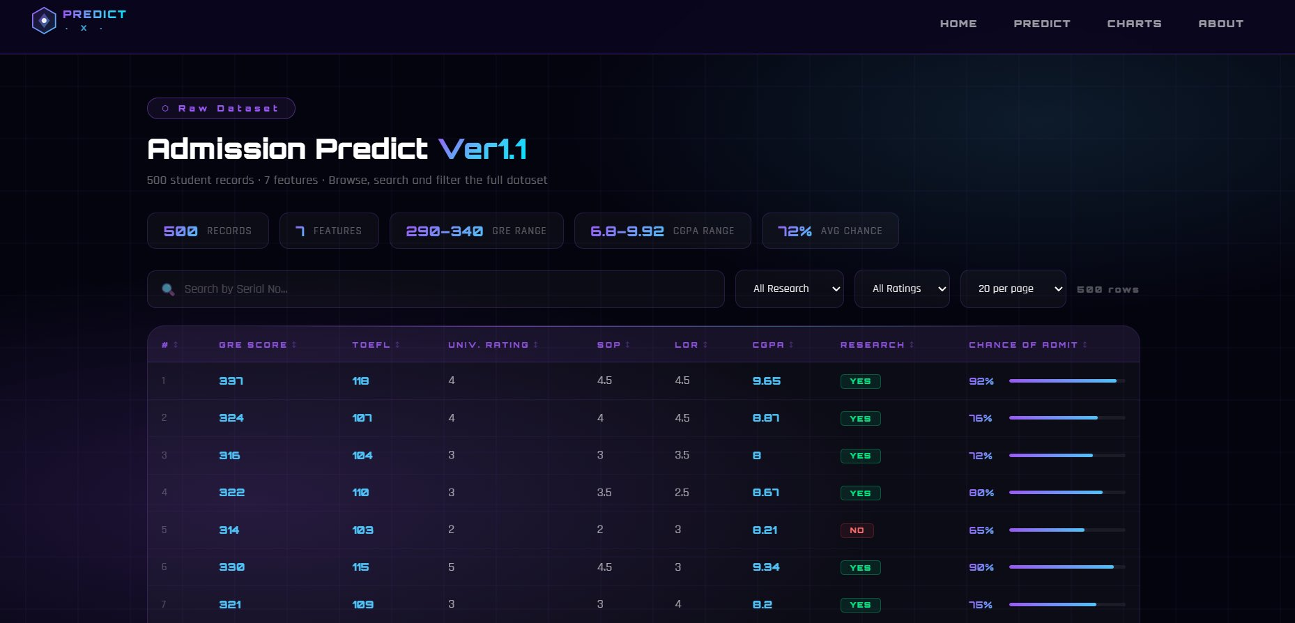
⬡ OUTPUT
Prediction Result & Dataset Explorer
Prediction Result
Raw Dataset Explorer
HIGH CHANCE ≥ 80%
Green badge — Strong admission probability
MODERATE ≥ 50%
Amber badge — Fair admission probability
LOW CHANCE < 50%
Red badge — Low admission probability

Slide 10
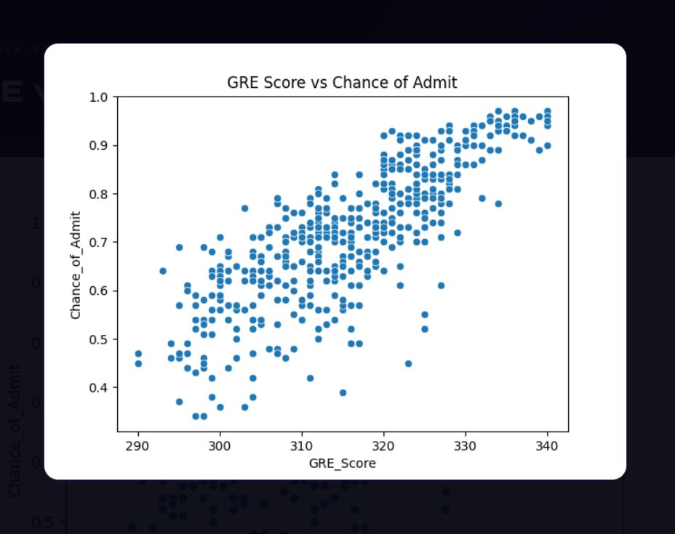
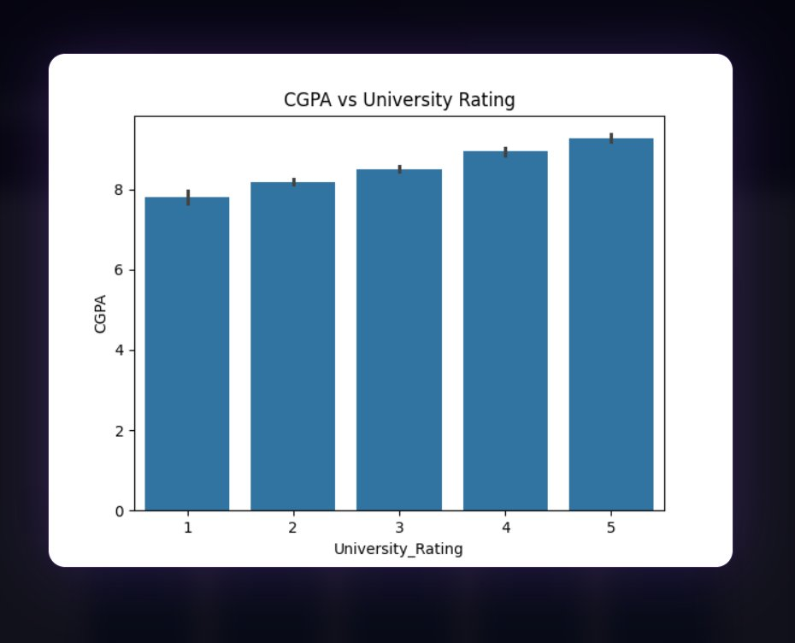
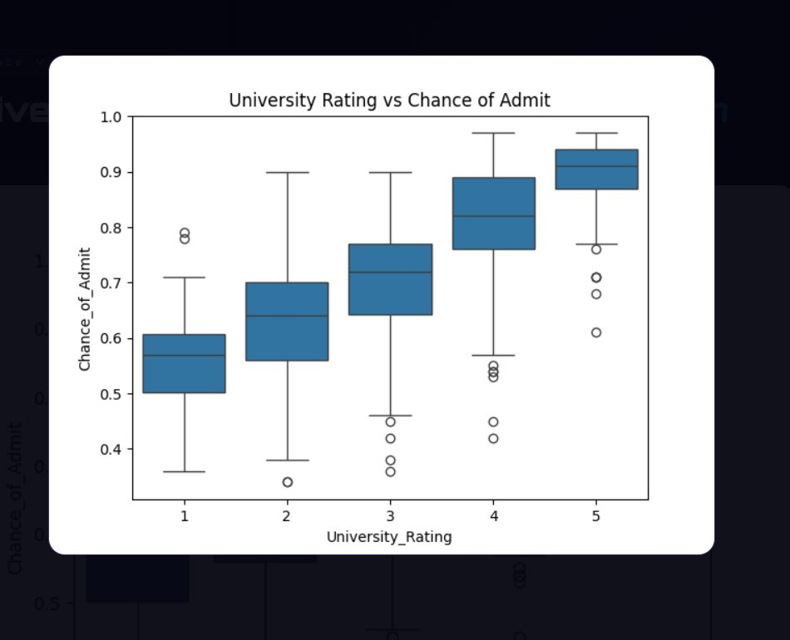
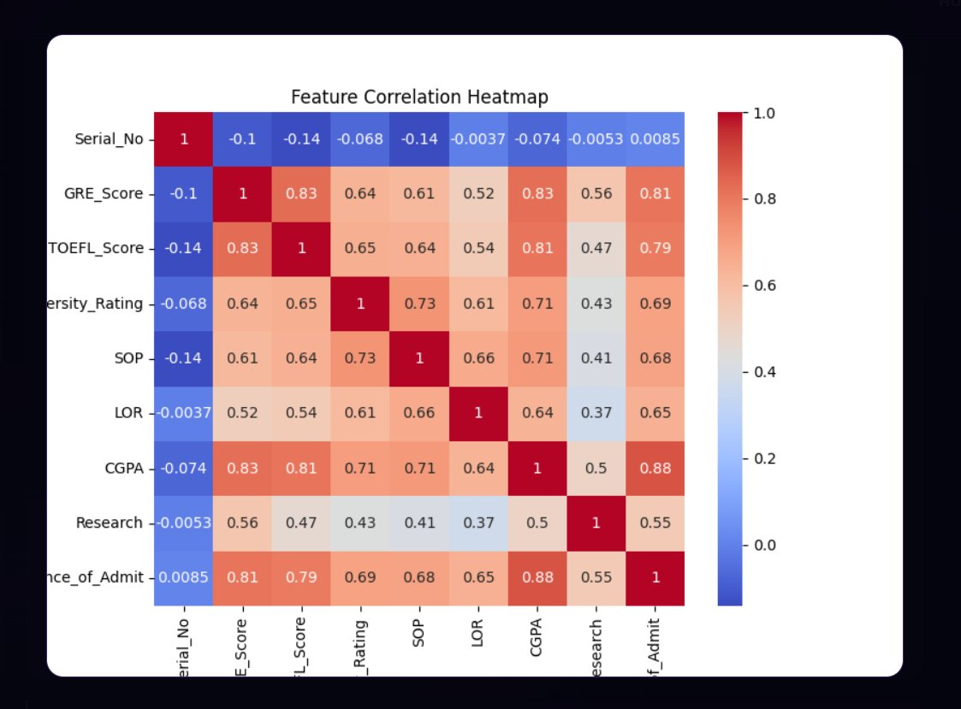
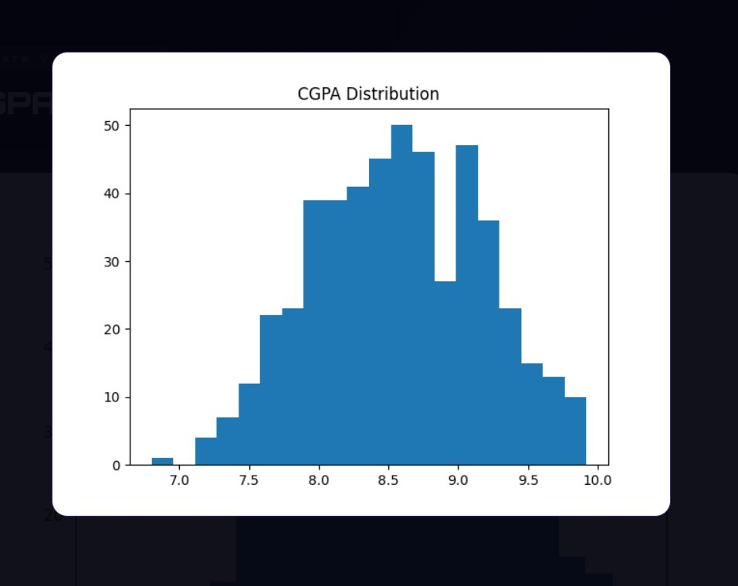
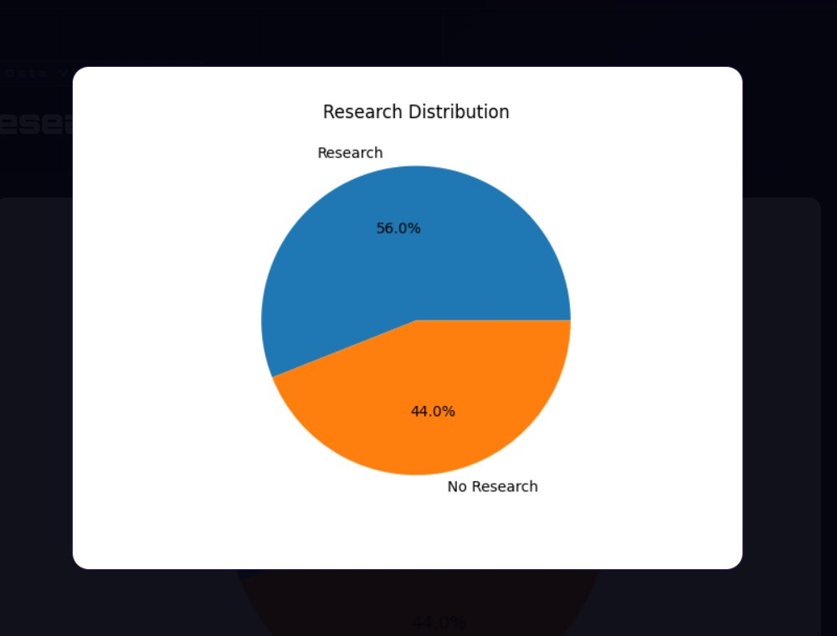
⬡ CHARTS
Data Visualizations
All 6 charts from the Analytics Dashboard
GRE vs Admission
CGPA vs Univ. Rating
Univ. Rating Dist.
Correlation Heatmap
CGPA Distribution
Research Analysis

Slide 11
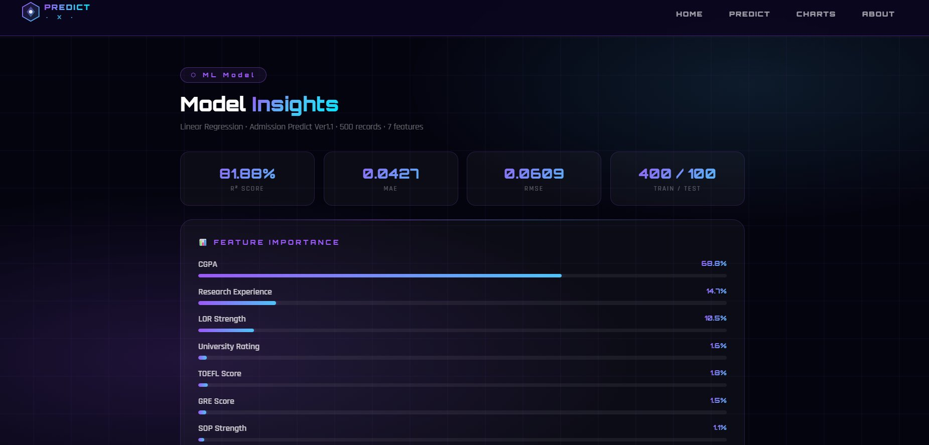
⬡ INSIGHTS
Model Insights Page
Feature Importance · Model Metrics · Training Pipeline · Coefficients

Slide 12
⬡ RESULTS
Results & Performance
96%
81.88%
0.0427
72%
MAE-Based Accuracy
R² Score
Mean Absolute Error
Avg Admission Chance
ACHIEVEMENTS
✓ Successfully built a Linear Regression model with 96% accuracy (MAE-based)
✓ CGPA identified as strongest predictor with 0.88 correlation to admission chance
✓ Research experience boosts admission probability by approximately 15%
✓ Interactive web dashboard with 6 charts, dataset explorer, and model insights page
✓ Three-tier classification: High Chance (≥80%), Moderate (≥50%), Low (<50%)
✓ Full-stack project: Python ML backend + Flask API + Cyberpunk-themed frontend

Slide 13
⬡ CONCLUSION
Conclusion & Future Scope
CONCLUSION
FUTURE SCOPE
The system successfully predicts graduate admission probability using academic features.
🗄️
Larger Datasets
Use real university admission data with 10,000+ records
Linear Regression model achieved 96% accuracy with minimal error (MAE: 0.0427).
🤖
Advanced Models
Implement Random Forest, Gradient Boosting for higher R²
CGPA is the most influential factor, followed by Research Experience and LOR.
📱
Mobile App
Develop iOS/Android version for on-the-go predictions
The web dashboard provides an intuitive interface for students to assess their chances.
🌐
Live Data
Data visualizations provide deep insights into admission patterns and feature relationships.
Integrate real-time university admission feeds via APIs
🔐
User Profiles
Add login system to save and track prediction history

Slide 14
⬡ REFERENCES
References
📊
Dataset
🐍
Python
Admission Predict Ver1.1 — Kaggle
Official Python Documentation
https://www.kaggle.com
https://docs.python.org
🤖
Scikit
🐼
Pandas
Scikit-Learn ML Library Docs
Pandas Data Analysis Library
https://scikit-learn.org
https://pandas.pydata.org
📈
Matplotlib
🌐
Flask
Matplotlib Visualization Docs
Flask Web Framework Docs
https://matplotlib.org
https://flask.palletsprojects.com

Slide 15
Thank You
PredictX — Graduate Admission Prediction System
Presented by: Shahil Pathan · Mubin Malek
Guide: Dr. Darshna Rajput | Dolat-Usha Institute | BCA 2025–26
🎓
🏛️
📅
BCA Program
Dolat-Usha Institute
2025–2026

